Slide 1
Broadband Home Networks
Chapter 15 Broadband Home Networks
Chapter 15
Week 13
Notes:
Chapter 14

Slide 2
Objectives
Chapter 15 Broadband Home Networks
  Broadband home networks overview
  Applications and application protocols
  Middleware between applications and transports
  Transport technologies
  Wired home networks
    Comprehensive view
    Lower layer protocols
    Ethernet-like protocols and management
    Power Ethernet
  Wireless home network
    WiFi (802.11a/b/g) wireless LAN
    802.11 standards and amendments
    Hierarchical network using access point
    Basic service set (BSS)
    MAC protocols: DCF, PCF, and hybrid
  Special network management considerations
    Security management
    QoS management
    Centralized management
    WLAN MIBs

Slide 3
In Chapter 1 we introduced the network segment associated with home and customer premises as one of the three segments of broadband network. The customer premises equipment (CPE) network in an enterprise environment is either an IEEE 802.3-based Ethernet local area network (LAN) or an IEEE 802. 11- based wireless LAN, also known as WiFi, or a hybrid of both.
Home network provides the opportunity to utilize multiple technologies besides Ethernet LAN and WiFi. HomePNA is implemented using a twisted-pair telephone cable medium, HomePlug takes advantage of power line wiring in the house, and cable utilizes the television coaxial cable. FireWirc is also a wired medium and is based on IEEE 1394 protocol to transmit high-speed video digital data and Universal Serial Bus (USB) with its own hub for transmitting digital data.
Wireless home network technologies include IEEE 802.15.1 Bluetooth and ultra-wide band (UWB) personal area networks (PANs) for short distances.
Residential gateway and the home network, which is the CPE network for residences, will be the subject of this chapter.
premises الأماكن – مباني

Slide 4
Home Networking Technologies
Chapter 15 Broadband Home Networks
Middleware and higher layer protocol networks
  HAVi (Home Audio-Video interoperability)
  Jini (Java-based middleware/network)
  UPnP (Universal Plug and Play)
  OSGi (Open Service Gateway initiative)
Lower Layer wired protocol based networks
  IEEE 802.3 Ethernet
  VHN (Versatile Home Network)
  IEEE 1394 (FireWire)
  Cable
  HomePNA (Home Phoneline Network Alliance)
  HomePlug (Power Line Communication, PLC)
Wireless LANs (Local Area Networks)
  IEEE 802.11 WLAN
  HomeRF
Wireless PANs (Personal Area Networks)
  IEEE 802.15.1 Bluetooth
  IEEE 802.15.3a UWB (Ultra Wideband)
  IEEE 802.15.4 Low data rate PAN

Slide 5
Networking Protocols
Chapter 15 Broadband Home Networks
Two Groups:
  Physical interconnects
    X-10
    CEBus (Consumer Electronics Bus)
    IrDA (Infrared Data Association)
    HomePlug
    HomePNA
    WiFi 802.11
    Bluetooth
    Ethernet
    IEEE 1394
    USB (Universal Serial Bus)
  Service or application middleware
    HAVi (Home Audio/Video interoperability)
    UPnP (Universal Plug and Play)
    Jini
    OSGi (Open Services Gateway initiative)

Slide 6
Application Layer Protocols
Chapter 15 Broadband Home Networks

Slide 7
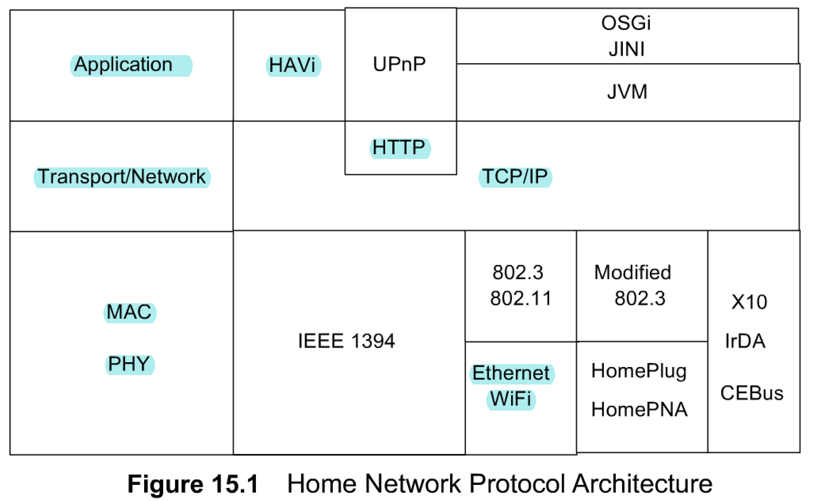
Home Network Protocol Architecture
Chapter 15 Broadband Home Networks
Figure 15.1 shows higher- and lower-layer protocols in an integrated architecture. The protocols used could be classified into application-layer protocols and transport-layer protocols, with middleware that acts as a gateway between the two.
Applications have protocol specifications to handle functions, services, and messages.
Transport protocols deal with transport functions belonging to transport, network, MAC, and physical layers.
at the application layer that there are four protocols— OSGi, JINI, UPnP, and HAVi.
  Notes
Open Service Gateway Initiative (OSGi) and JINI, which are both based on Java Virtual Machine (JVM) and use Transmission Control Protocol (TCP)/Internet Protocol (IP) for transport and network layers.
Universal Plug and Play (UPnP) is based on HTTP
Home Audio-Video Interoperability (HAVi) and UPnP show IEEE 1394 for the MAC and PHY layers.
OSGi and JINI use either 802.3 or modified 802.3 with HomePlug and HomePNA or physical layers.
XI0, Infrared Data Association (IrDA) data, and CEBus are also shown as they do interface with IP.
HAVi focuses on home entertainment and AV devices.
JINI technology considered as a middleware technology and comprises a set of APIs and network protocols.

Slide 8
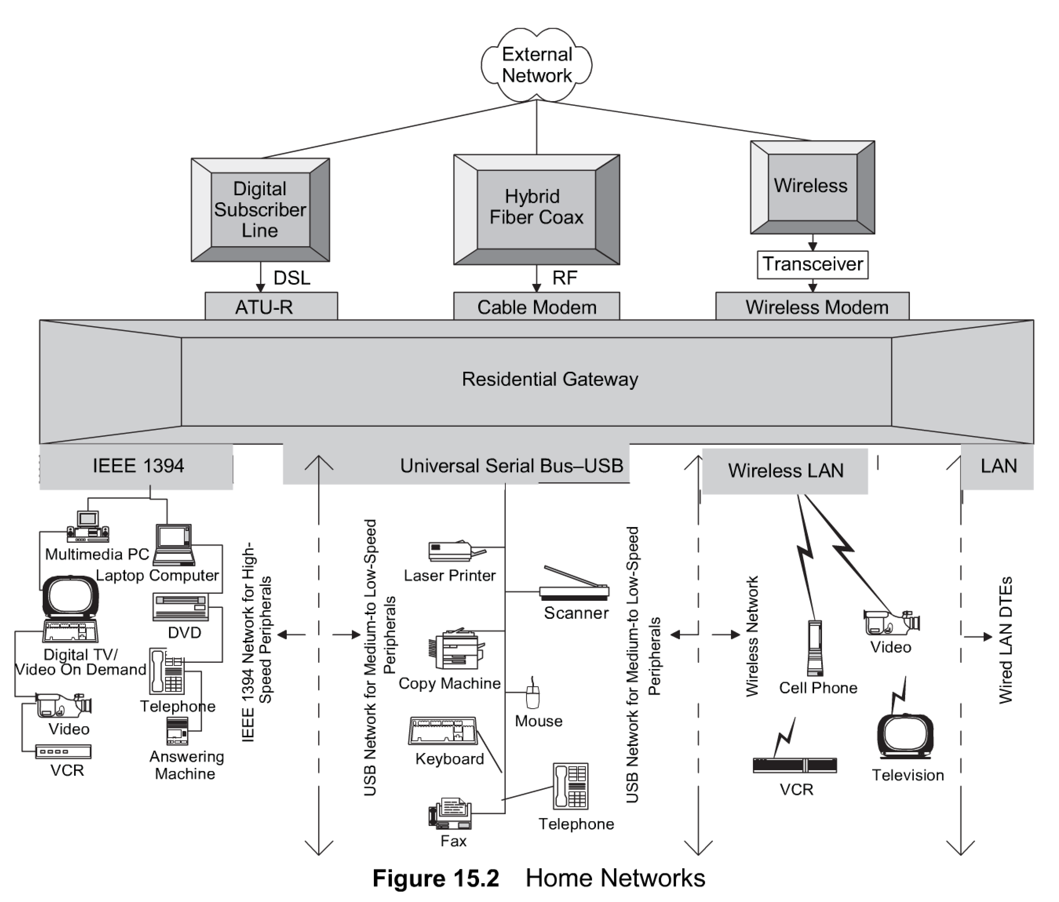
Home Networks
Chapter 15 Broadband Home Networks
The medium of transport for the home network could be either a wired or a wireless medium, or a hybrid of the two.
Wired medium could be any one of the following: copper wire such as power line, twisted pair such as phone line, Cat 3 or Cat 5 Ethernet cable, coaxial cable such as the one used for TV distribution, or optical fiber.
Modern homes are being built wired with optical fiber. Wireless transmission is the radio frequency (RF) with single or multiple antennas. Cabling could be hybrid transmission with wired distribution in the home and wireless inside the rooms.
Figure 15.2 shows a comprehensive view of the home network. The access network is one of three choices, namely DSL, HFC, or wireless. Each feed terminates in the respective modem, whose output is connected to a residential gateway. Although a personal computer functions as a residential gateway, in the future this would be a dedicated intelligent device with built-in communication and application modules.
In Figure 15.2 the residential gateway has four types of distribution networks connected to it. The USB network has low- and high-speed digital data devices connected to it. The very high-speed digital triple play devices comprise IEEE 1394 network, also known as FireWire® branded by Apple. The third type of network is LAN, the predominant one being wired Ethernet network. Other less popular types of LANs are HomePNA using telephone cable or HotmePlug using power line. They could be based on the above-mentioned schemes of either. The fourth home distribution network shown in Figure 15.2 is WiFi, wireless LAN network based on IEEE 802. 1 1 . We will next address wired and wireless technologies based on various physical media.
  Notes
Three access networks and modems
Four types of distribution networks

Slide 9
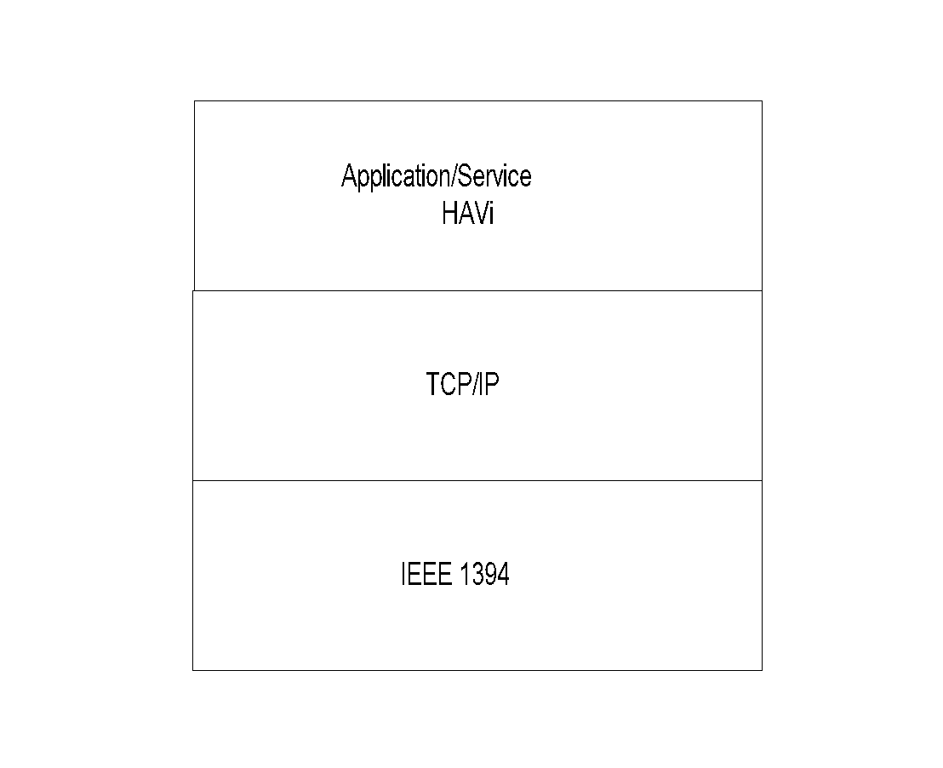
HAVi Protocol Architecture
Chapter 15 Broadband Home Networks
Home Audio-Video interoperability
  Notes
Application for home entertainment and AV devices
HAVi Components
  Device
    FAV (Full Audio Visual)
    Intermediate AV
    Base AV
    Legacy AV
  Device control module (DCM): Aggregate of FCMs
  Functional control module (FCM): Controls application functions
Peer-to-peer environment

Slide 10
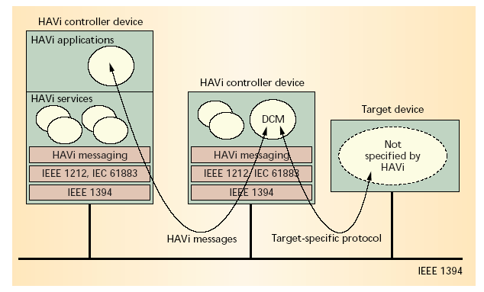
HAVi Communication
Chapter 15 Broadband Home Networks
  Notes
  Lower layer: IEEE 1394
    Function control protocol: IEC 61883.1
    Device control protocol: IEEE 1212
    HAVi messages
  Services
    Discovery Messaging
    Lookup Events
    Configuration Reservation
    Device control User interaction

Slide 11
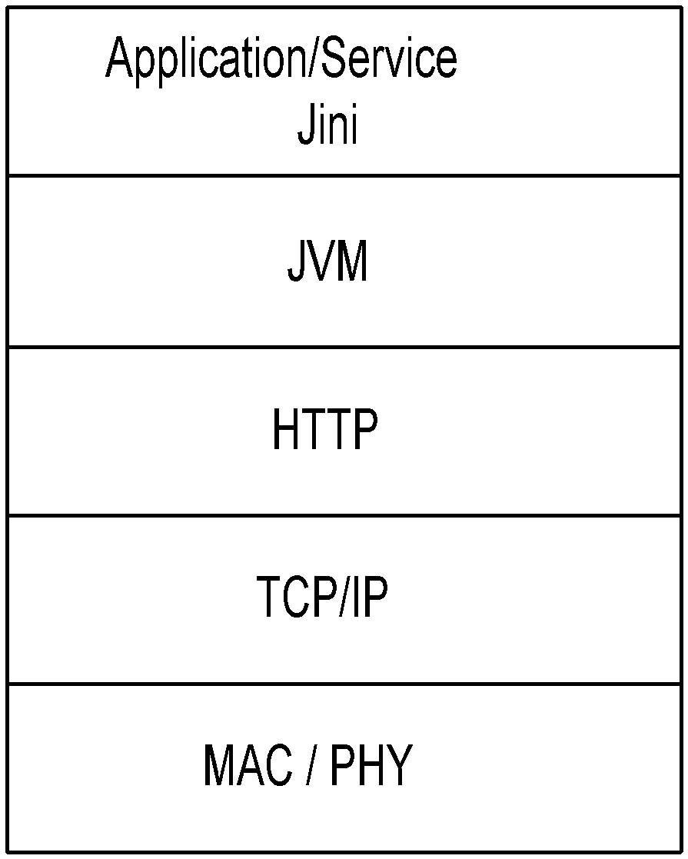
Jini Middleware
Chapter 15 Broadband Home Networks
  Notes
Components
  Device – Java object / Client
  Access: RMI (Remote Method Invocation)
  Services
    Lookup
    Discovery
Based on Java platform
Distributed environment for devices to communicate; Not housed in a single computer
Forms impromptu communities – Group of shared services
Federation: Jini communities linked together
Jini surrogate host to handle non-Jini host
JiniME (Mobile Edition) for mobile devices

Slide 12
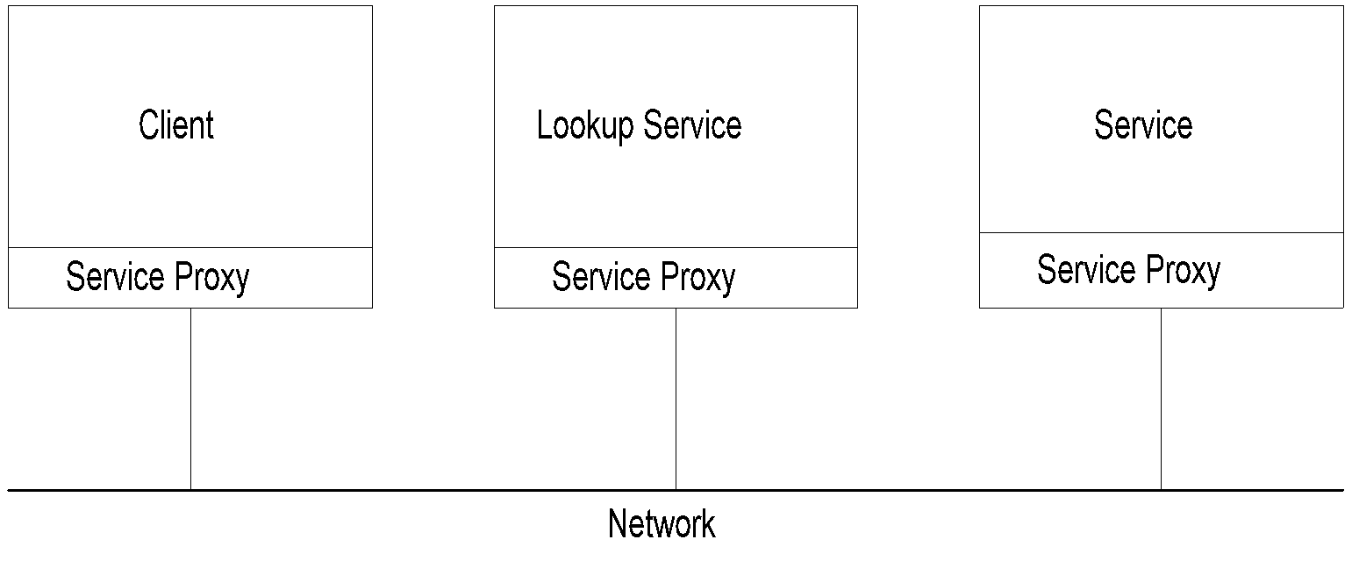
Jini Network: Service
Chapter 15 Broadband Home Networks
  Notes
Lookup Service:
  Client requests service (e.g., clock)
  Lookup service: locator
  Service provides the service (e.g., TV)
Network: Any network supporting Jini service

Slide 13
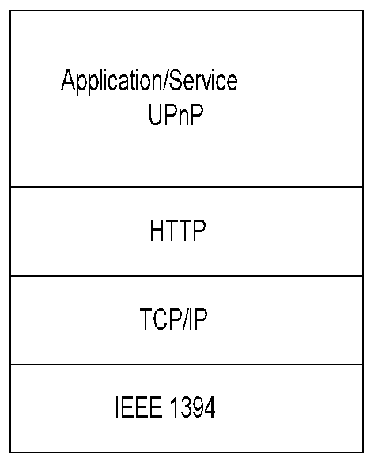
UPnP Protocol Architecture
Chapter 15 Broadband Home Networks
Universal Plug and Play
UPnP is architecture for pervasive peer-to-peer network connectivity of smart home wired and wireless devices. It is Microsoft's initiative for home networking and uses Web technologies for device description and control. It also contains a set of APIs, but its strategy is different from that of JINI.
JINI APIs are a contract between vendors, and UPnP allows vendors to build the APIs.
  Notes
Universal plug and play
Active addition and deletion of devices
Components
  Devices
  Services
  Control points
Peer-to-peer network

Slide 14
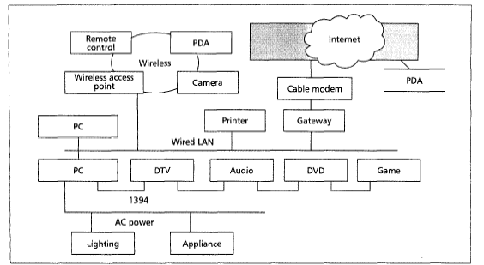
UPnP Network
Chapter 15 Broadband Home Networks
  Notes
Underlying networks with standard protocols:
  HomePlug
  IEEE 1394
  LAN
  WLAN
Gateway and cable modem link to Internet
Dynamic configuration of devices offering services requested by control points
Needs zero-configuration
Automatic discovery of devices

Slide 15
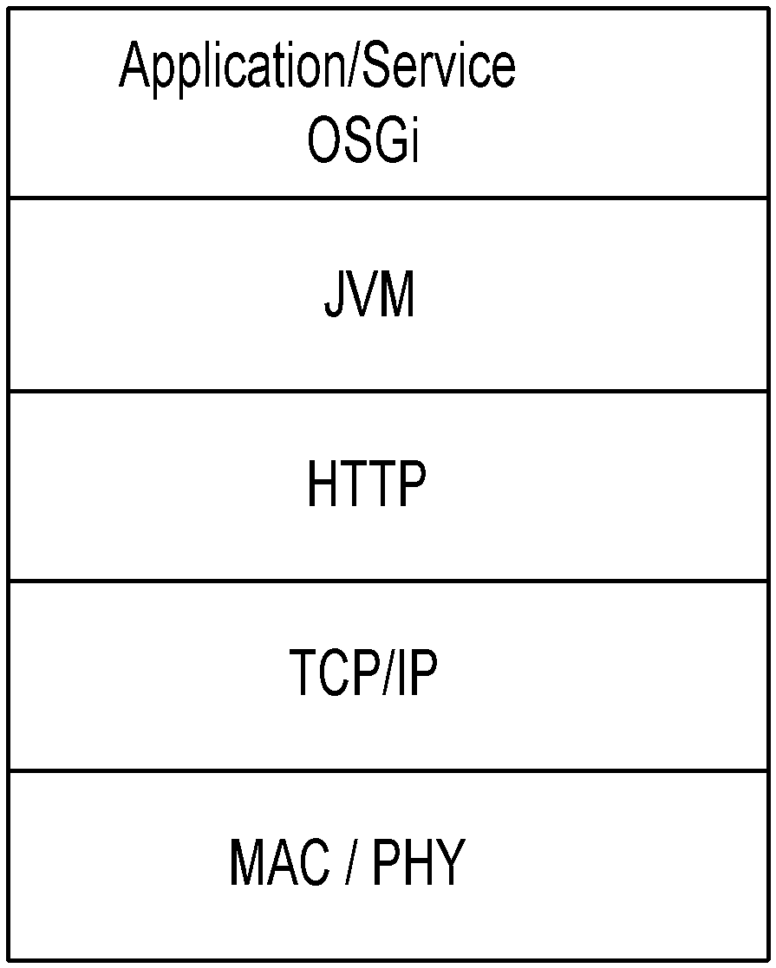
OSGi Gateway
Chapter 15 Broadband Home Networks
OSGi is a residential gateway platform that supports the integration of different home networking technologies and the delivery of different services from service providers. Based on Java technology, different software components, called bundles, can be downloaded remotely to the gateway.
Just as most managed applications are managed as part of the Enterprise Management System using Simple Network Management Protocol (SNMP) agents, residential applications could also have SNMP-like agents built in them.
As of now, home network applications are more in a research stage. Application and middleware technologies are based on TCP/IP protocol for the transport and network layers used for transport protocols.
  Notes
OSGi: Open Service Gateway initiative
Platform for residential gateway
Specifies API only, not underlying implementation;
Platform and application independent
Service and device discovery functions
Imports multiple discovery protocols and registers
them as OSGi services

Slide 16
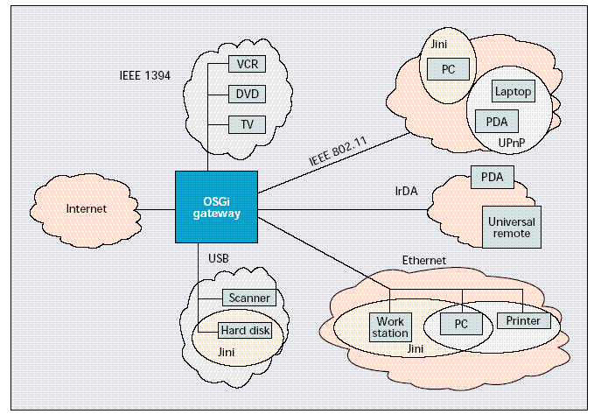
OSGi Home Network
Architecture
Chapter 15 Broadband Home Networks
Source: Dobrev, et.al., IEEE Communications Magazine, Aug. 2002
  Notes
سكني
Residential OSGi Gateway
External link to Internet via embedded modem with interface to cable, DSL, or wireless access network
Intra-home networks with multiple protocols integrated with OSGi
Jini creates impromptu communities automatically
IEEE 1394 network for AV devices
IEEE 802.11 and Ethernet networks for mobile fixed data devices
Imports discovery services from other protocol networks

Slide 17
Lower Layer Networking Protocols
Chapter 15 Broadband Home Networks
WIRED HOME DISTRIBUTION NETWORK
Wired transport protocol for transport and network layers is TCP/IP. The lower-layer protocols address physical and MAC layers

Slide 18
Lower Layer Protocols for Networked Appliances
Chapter 15 Broadband Home Networks
Category | Appliance | Protocol
Home Automation and Control | Lighting, Appliances, Climate Control | EIB, LonWorks, X10, CEBus
Entertainment | A/V Equipment, TV, PC | IEEE 1394
Communications | Telephone, Cell Phone, Intercom | IEEE 1394, HomePNA
Computers and Information | PC, Peripherals, PDA | Ethernet, WiFi
  Notes
Issues:
  rt, near-rt, and non-rt, requirements
  Multiplicity of component networks
  Backbone QoS
  Interoperability التوافقية
X-10 protocol communicates between the transmitter and the receiver by sending RF bursts over power line wiring.

Slide 19
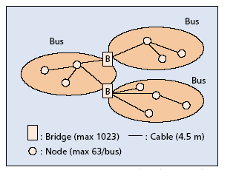
IEEE 1394
Chapter 15 Broadband Home Networks
IEEE 1394 is more suitable for home networking as it can be applied to audio and video in addition to IP data transmission. It was originally developed as a high-performance serial bus by Apple, known as FireWire.
Source: Nakagawa, et. al.
  Notes
Wired IEEE 1394
  Applicable to audio, video, and high-speed data
  Transport speed 100, 200, and 400 Mbps
  1394b: 800 and 1600 Mbps
  Extension to 3.2 Gbps in the future specifications
  Supports asynchronous and isochronous
  Flexible topology; supports daisy chaining and node branching
  Active connect and disconnect
Wireless /1394 bridge

Slide 20
USB
Chapter 15 Broadband Home Networks
Universal Serial Bus
USB 1.0 1.5 Mbps Low speed Cable length = 3m
USB 1.1 12 Mbps Full Speed Cable length = 3m
USB 2.0 400 Mbps High speed Cable length = 5m
The USB is an alternative to Ethernet as a computer peripheral interface. However, it is data-centric as opposed to multimedia and limited to PC peripheral applications.
Source: Nakagawa, et. al.
  Notes
Universal Serial Bus (USB)
  Alternative to Ethernet as a computer
  peripheral interface
  Data-centric, not multimedia-oriented

Slide 21
Residential Ethernet
Chapter 15 Broadband Home Networks
Medium
  UTP-CAT5 (Unshielded twisted Pair Category 5); Maximum 100 meters
  Optical Fiber in new homes
Requirements different from enterprise Ethernet
  Multiplicity of multimedia and networked appliances
  Single physical port, multiple logical / channel interface handled by ifStackTable (RFC 2863)
  ifOctets redefined to handle 10 Gbps
  IP phones wired with powered Ethernet cable
  New MIB for powered Ethernet
  Notes
Home Phoneline Network Alliance (HomePNA) is a technology that can distribute broadband over the phone line in the house.
HomePlug, also known as power line communication (PLC), distributes data over power line in the house and is suitable for low data-rate transmission for applications such as electronic device control.
In broadband service, IP telephony allows voice service to be transported over the same infrastructure as data service.

Slide 22
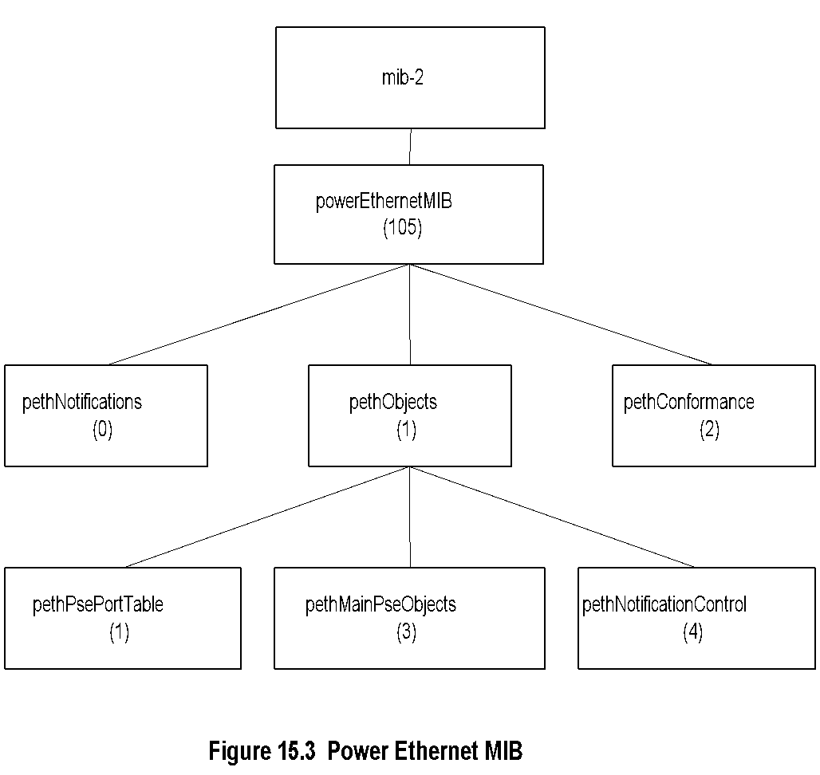
Power Ethernet MIB
Chapter 15 Broadband Home Networks
  Notes
pse: Power sourcing equipment
pethObjects has three groups:
  pethPsePortTable: management objects for status of PSE device ports
  pethMainPseObjects: MOs for PSE device
  pethNotificationControlTable: Notifications

Slide 23
IEEE 802.11
Wireless LAN
Chapter 15 Broadband Home Networks
There are three lower-layer wireless groups: IrDA, WLAN/WiFi, and wireless PAN.
The IrDA has developed specifications for infrared wireless communication.
Next to Ethernet LAN, the most popular home network is WLAN. IEEE 802. 11
There are several wireless PANs, each for a specific application.
Bluetooth, specified in IEEE 802.15.1, is intended for short range and could cause interference.
UWB Because of its low-power requirement along with high resistance to noise background, it has high potential as PAN. There are numerous network applications for home devices that require a low data rate, such as appliance control.

Slide 24
802.11 - PHY & MAC
Chapter 15 Broadband Home Networks
MAC Layer
  CSMA/CA (CSMA/ Collision Avoidance) is used: (CSMA/CD in 802.3)
  BSS Basic service set comprise AP (Access Point) and STAs (Stations); a.k.a. Wi-Fi
  MAC sublayer defines two medium access coordination functions by AP:
    DCF Distributed coordination function
      Asynchronous
      Contention-based
    PCF Point coordination function (optional)
      Synchronous
      Contention-free
PHY Layer
  802.11b @ 2.4 GHz & data rate 11 Mbps
  802.11a @ 5 GHz & data rate 54 Mbps
  802.11g extends 802.11b to 54 Mbps with OFDM
  Notes
IBSS: Independent BSS
  Ad-hoc configuration of 802.11
IEEE 802.11 WLAN standard covers the MAC sublayer and physical (PHY) layer of the open system
interconnection (OSI) network

Slide 25
802.11 Standards & Amendments
Chapter 15 Broadband Home Networks
Table 15.1 IEEE 802.11 Standards and Amendments
802.11a | 54 Mbps data rate 5.15 MHz to 5.35 and 5.4 MHz to 5.825 MHz
802.11b | 11 Mbps data rate at 2.4 GHz
802.11e | Addresses QoS issues
802.11f | Addresses multivendor AP interoperability
802.11g | Higher data rate extension to 54 Mbps in the 2.4 GHz
802.11h | Dynamic frequency selection and transmit power control for operation of 5 GHz products
802.11i | Addresses enhanced security issues
802.11j | Addresses channelization in Japan’s 4.9 GHz band
802.11k | Enables medium and network resources more efficiently
802.11v | Wireless network management (in preparation)
  Notes

Slide 26


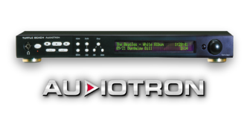

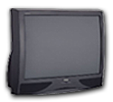


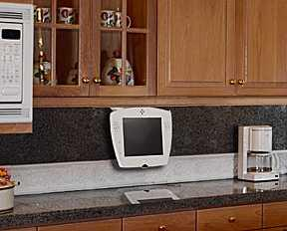

Residential WLAN
Chapter 15 Broadband Home Networks
Den
Dining Room
Bedroom
Figure 15.4 shows how a typical residence is wired on the WiFi network. A single AP or residential gateway could serve the entire house. It is connected to the Internet via an access network. In the Eastern hemisphere and in non-wooden buildings, the CPE distribution network may comprise a hybrid network with wired Ethernet to individual floors or rooms and WLAN as the last link.
MP3 Player
PC
WebPad
Kitchen
Touch Pad
AP
Family room
Kitchen
Internet
Figure 15.4 Residential WLAN
There are two modes of configuring WLAN networks, hierarchical and ad hoc.

Slide 27

WiFI Network Infrastructure
Chapter 15 Broadband Home Networks
AP
Internet
Layer 2/3
Switch
There are several issues associated with the deployment and the management of WLAN. These include scalability, provisioning, real-time and non-real-time data flow, accessibility range, power management, interference from other systems operating in the same spectrum such as Bluetooth, security management, and QoS management.
802.11
IP
User
802.3
Figure 15.5 WiFI Network Infrastructure
  Notes
Layer 2/3 bridge is traditional Ethernet hub
AP performs security functions

Slide 28
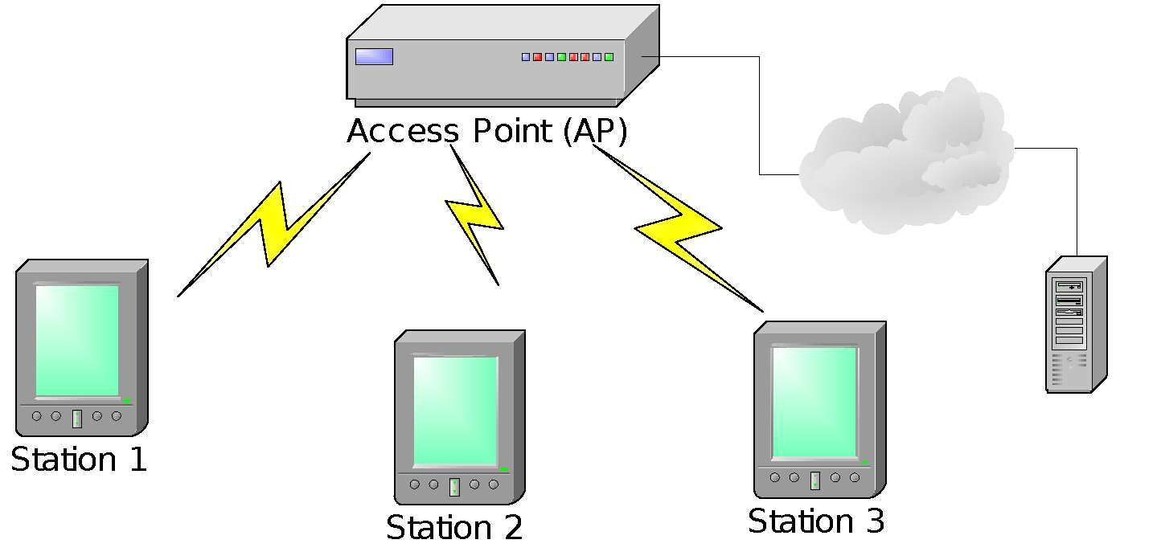
Enterprise WLAN
Chapter 15 Broadband Home Networks
Figure 15.6 Enterprise WLAN
  Notes
An access point (AP) and multiple stations (STAs)
AP works as a bridge
Every transmission is between AP and STA(s)

Slide 29
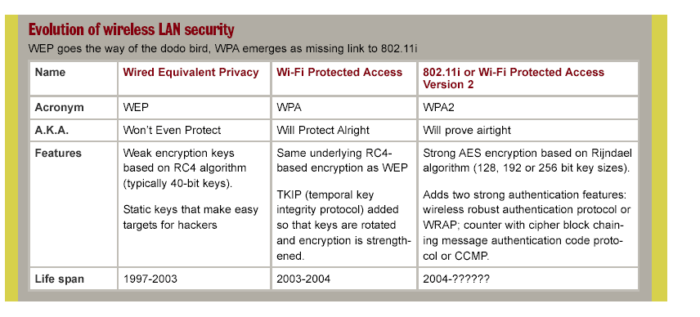
Evolution of WLAN Security
Chapter 15 Broadband Home Networks
WEP Wired Equivalent Privacy
WPA WiFi Protected Access – IEEE 802.11i based
WPA2 802.11i (?)
  Notes

Slide 30
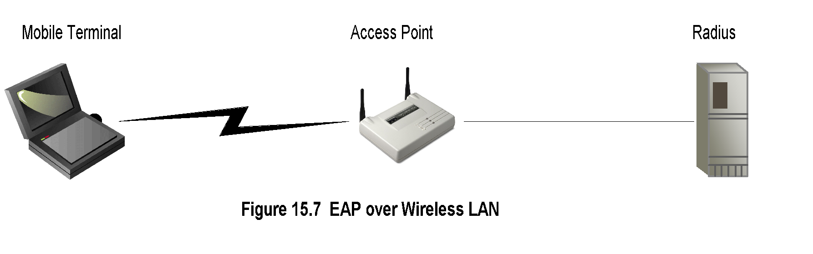
Security Management
Chapter 15 Broadband Home Networks
Service providers use proprietary schemes, what
is described as the "Walled Garden" approach.
  Notes
Evolution:
WAP (Wireless Application Protocol) Security
  WAP Wireless transport layer security (WTLS)
    Based on transport layer security (TLS) or secured sockets shell (SSL)
    “Walled garden” “vertical” integrated approach
WEP Wired Equivalent Privacy
WPA WiFi Protected Access
WPA2 WPA with IEEE 802.11i
3G network security
  3GPP (Third Generation Partnership Project) and 3GPP2 plan for IP to wireless device
  Open standard SNMP-based

Slide 31
WLAN Broadband QoS Issues
Chapter 15 Broadband Home Networks
Broadband comprises:
  Voice: Real-time data
  Video: Streaming data with/without delay
  Data: Non-real time data
Broadband QoS determined by MAC and PHY layers
The QoS Parameters:
  Datarate
  Delay bound
  Jitter
Two types of media access (MAC)
  DCF (Distributed Control Function): CSMA/CA
  PCF (Point Control Function): Polled Xmission
Both DCF and PCF fail to satisfy broadband service
Range dependencies
  Power level
  Antenna choice:
    Diversity antenna focuses beam
    Diversity reception improves S/N ratio
    MIMO (Multiple Input Multiple Output) technology enhances reception
  Notes

Slide 32
IEEE 802.11e QoS Table
Chapter 15 Broadband Home Networks
Table 15.2 IEEE 802.11e QoS Table
UP (user priority) | AC (access category) | Service type
2 | 0 | Best Effort
1 | 0 | Best Effort
0 | 0 | Best Effort
3 | 1 | Video Probe
4 | 2 | Video
5 | 2 | Video
6 | 3 | Voice
7 | 3 | Voice
  Notes

Slide 33
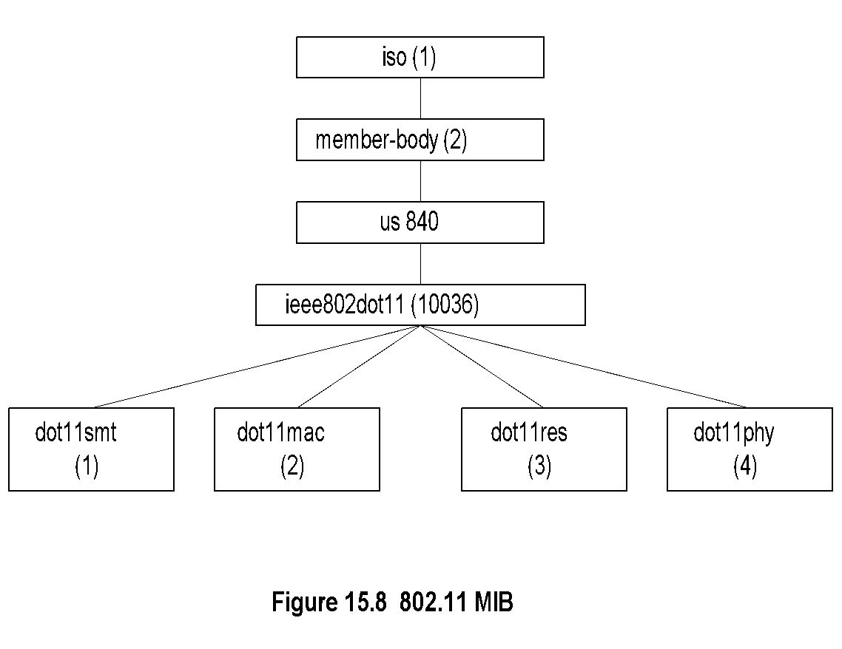
802.11 MIB
Chapter 15 Broadband Home Networks
  Notes
Entity | OID | Description
dot11smt | ieee802dot11 1 | Station management attributes: WEP security, power, transmission
dot11mac | ieee802dot11 2 | Mac attributes
dot11res | ieee802dot11 3 | Resource type attributes
dot11phy | ieee802dot11 4 | Physical attributes
Network Management: Principles and Practice
© Mani Subramanian 2010
*

Slide 34
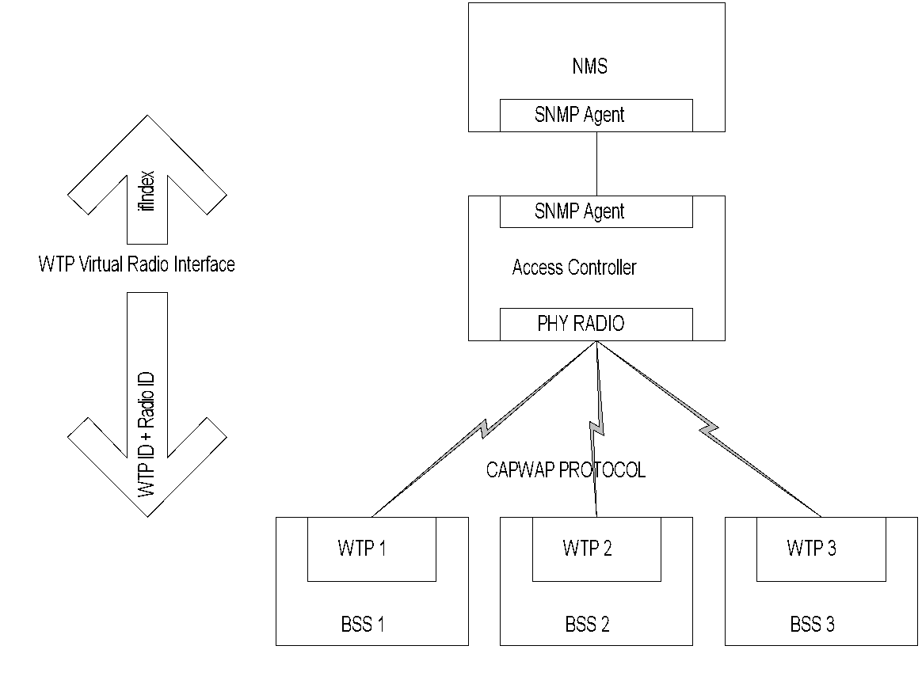
Centralized Management of WLANs
Chapter 15 Broadband Home Networks
(Wireless LAN)
As a prelude to developing a MIB that makes all WLAN components, including APs, interoperable, the broad set of AP functions has been divided into two categories: 802.11 functions, which include those that are required by IEEE 802.11 standards, and Configuration and Provisioning of Wireless Access Point (CAPWAP) functions, which include those that are not required by IEEE 802.1 1, but are deemed essential for control, configuration, and management of 802. 1 1 WLANs on a centrally managed basis
Figure 15.9 Centralized Management of WLANs
  Notes
CAPWAP interoperable protocol standard
Centralized Access Controller manages multiple BSSs via Wireless Termination Points (WTPs)
CAPWAP – IETF compatibility achieved by one-to-one relationship between ifIndex and WTP ID + Radio ID

Slide 35
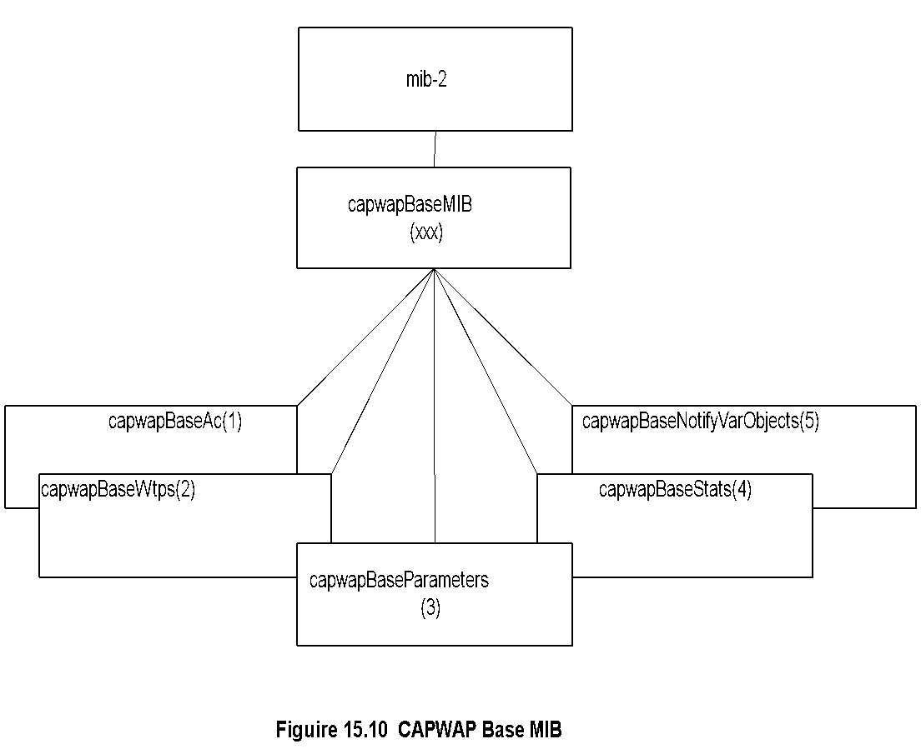
CAPWAP Base MIB
Chapter 15 Broadband Home Networks
  Notes
CAPWAP MIB in proposal stage

Slide 36
CAPWAP Base MIB
Chapter 15 Broadband Home Networks
Entity | OID | Description
capwapBaseObjects | capwapBaseMIB 1 | CAPWAP MIB objects
capwapBaseAc | capwapBaseObjects 1 | Access Controller Objects group
capwapBaseAc NameListTable | capwapBaseAc 9 | Objects that display AC name list
capwapBaseMac AclTable | capwapBaseAc 10 | Set of objects that configure station ACL
capwapBaseWtps | capwapBaseObjects 2 | Wireless Termination Point Objects group
capwapBaseWtp StateTable | capwapBaseWtps 1 | Objects that display WTP CAPWAP FSM state
capwapBaseWtp Table | capwapBaseWtps 2 | Objects that display and control WTPs in running state
capwapBaseRadio BindTable | capwapBaseWtps 3 | Objects that display mapping relationship between specific interface of 'WTP Virtual Radio Interface' ifType and PHY radio
capwapBaseStation Table | capwapBaseWtps 4 | Objects that display stations which are accessing the wireless service provided by the AC
capwapBaseWtpRebootStatsTable | capwapBaseWtps 5 | Objects that display WTPs' reboot statistics
capwapBaseRadioStatsTable | capwapBaseWtps 6 | Objects that display statistics on radio’s behavior, and reasons why the WTP radio has been reset.
capwapBaseParameters | capwapBaseObjects 3 | CAPWAP Base Parameters group
capwapBaseStats | capwapBaseObjects 4 | CAPWAP Statistics group
capwapBaseNotifyVar Objects | capwapBaseObjects 5 | Objects used only in notifications

Slide 37
IEEE 802.15
WPANs
(Wireless Personal Area Networks)
Chapter 15 Broadband Home Networks

Slide 38
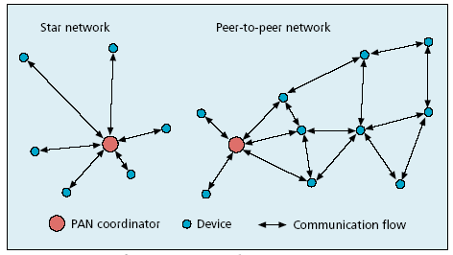
WPANs
Chapter 15 Broadband Home Networks
Source: Callaway, et. al., IEEE Communications Magazine, Aug. 2002
  Notes
802.15.1 Bluetooth base line standard
802.15.2 Coexistence of 802 wireless technologies
802.15.3 High-rate radio (>20 Mbps)
802.15.4 Low-rate radio (<200 kbps)

Slide 39
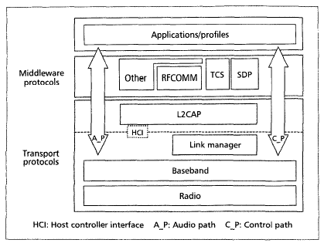
Bluetooth Protocol Stack
Chapter 15 Broadband Home Networks
  Notes
Short range up to 10m
2.042 GHz to 2.483 GHz band
79 channels of 1 MHz width
Data rate 1 Mbps
Time division multiplexing
Master-slave architecture
Voice support synchronous connection-oriented link
Data support using asynchronous connectionless link

